Slide 1
AI developer bootcamp: Cognitive Toolkit
James Carpinter
CTO, Zarmada | Microsoft Regional Director
james@zarmada.com | @jamescarpinter

Slide 2
How do I <insert your feature here>?
Language
Dynamics 365
Skype
Knowledge
Speech
Browser
Azure Bot Service
Cognitive Services
Vision
Cortana
Web
Azure ML
Cognitive Toolkit

Slide 3
Cognitive Toolkit

Slide 4
Time to get serious.

Slide 5
Anomaly detection
Unit step function
Principal component analysis
Probability theory
Linear algebra
Cross-validation
Python
Information theory
Bias-variance tradeoff
Test set
Differential equations
False negatives
Logistic regression
Perceptron
Feature engineering
Scala
Reinforcement learning
Activation functions
Dimensionality
Multi-class classification
Accuracy
False positives
Sensitivity
Stochastic gradient descent
Training set
Recommender systems
Spark clusters
Statistics
Precision
Support vector machines
Normalization
Deep belief networks
Algorithms
K-means clustering
GPUs
Multivariate calculus
Sigmoid function
R
Recurrent neural networks
Sentinel values
Recall
Complex optimizations
Convolutional neural networks
Generative adversarial neural networks
Deep belief networks

Slide 6
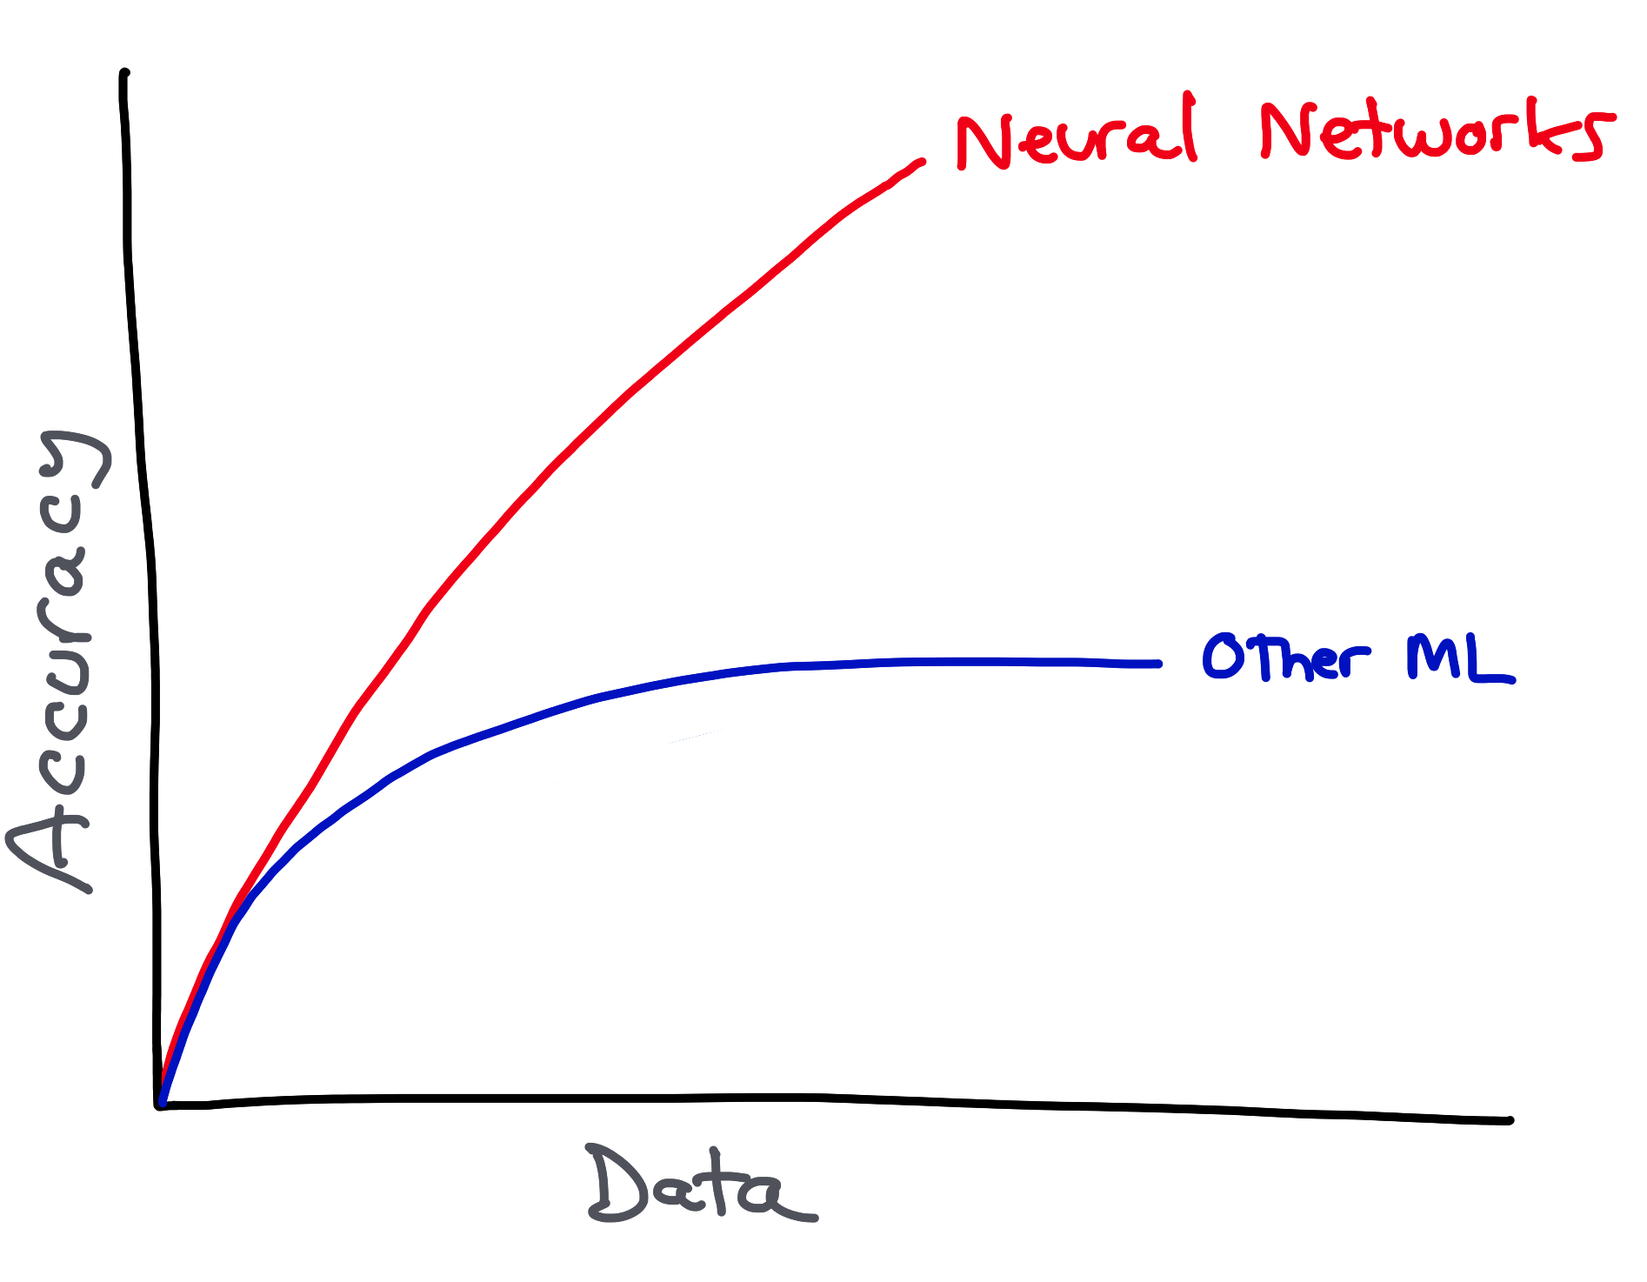
Credit: Bill Barnes; Inspired by: Andrew Ng

Slide 7
What is a Neural Network?
Age | Income | Education | Gender | Housing
61 | $65,000 | Moderate | F | Own
42 | $72,000 | High | F | Rent
18 | $25,000 | Moderate | M | Other
22 | $36,000 | Low | M | Rent
Training data
31 | $52,000 | High | M | ?
What we know
“features”, “attributes”
Thing to predict
“class”, “label”

Slide 8
What is a Neural Network?
Age
31
3.1
input
hidden
output
Income
52,000
5.2
0.23
Housing
0.0
0.62
Rent
Education
High
1.0
0.15
Gender
M
-1.0

Slide 9
What is a Neural Network?
0.1
b = 2.0
0.1 × 4.0 + 0.2 × -5.0 + 0.3 × 6.0 = 1.2
W₀ = 4.0
1.2 + 2.0 = 3.2
0.73
activation(3.2) = 0.73
0.2
W₁ = -5.0
0.73
0.3
W₂ = 6.0

Slide 10
What is a Neural Network?
Network Design
Number of layers, number of units
Dependent on concept complexity
Experimentation often required
Activation Function
Enables non-linear models
Examples include sigmoid, hyperbolic tangent, ReLU, softmax, …
Loss Function
Measure the performance during training
Examples include cross entropy
Trainer
Mechanism for finding optimal weights; typically based on backpropagation
Examples include stochastic gradient descent, Adam
Overfitting
Stop model from over-optimizing on training data set
Examples include Dropout

Slide 11
What is a Neural Network?
Build
Configure your model: units, layers, functions, trainers Each usually has its own parameters
Train
Use your training dataset to build the model
Often >70% of available dataset
Test
Use your test dataset to validate the model This dataset hasn’t been seen by the model yet
Predict
If the model is good enough, use it in production to make predictions on unseen data

Slide 12
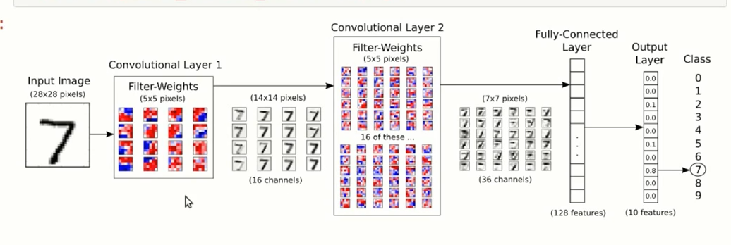
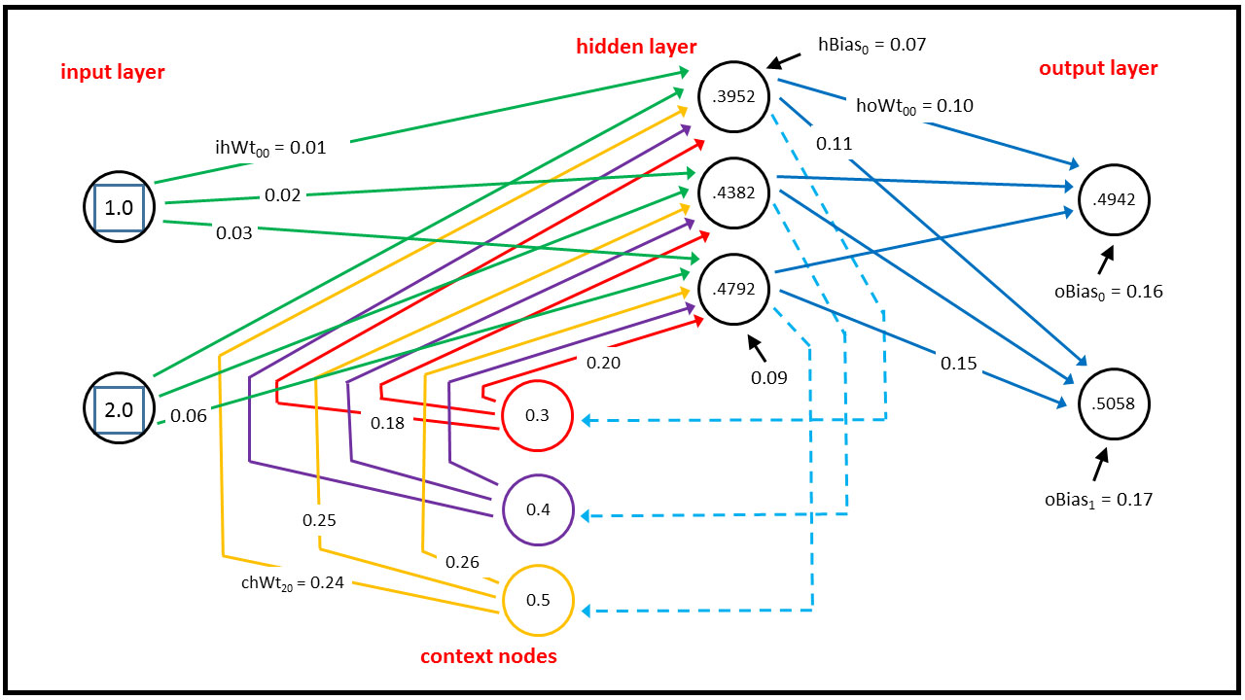
What is a Neural Network?
Convolutional Neural Networks
For image processing
Pixel-by-pixel doesn’t scale
Use filters of different sizes to detect edges, colors, vertices
Recurrent Neural Networks
For language processing
I.e. sequences, time-series data
Key distinction: loops

Slide 13
Cognitive Toolkit
Microsoft’s open source deep learning toolkit
AKA; roots in Speech research
Now at v2, standalone product (i.e. not a research project)
Production-ready models
Internal == external: developed in the open
External contributions from MIT, Stanford
“Ease” of use
Focus on the what, not the how; express neural networks by composing blocks
Fast
Optimized at multiple levels; leads competitors esp. on GPU
Scalable
Multi-GPU, multi-server scale out; can be run on Azure Batch
Flexible
Extend with Python, C++; build with Keras; integrate with C#

Slide 14
Cognitive Toolkit
 | Caffe | CNTK | MxNet | TensorFlow | Torch
FCN5 (1024) | 55.329ms | 51.038ms | 60.448ms | 62.044ms | 52.154ms
AlexNet (256) | 36.815ms | 27.215ms | 28.994ms | 103.960ms | 37.462ms
ResNet (32) | 143.987ms | 81.470ms | 84.545ms | 181.404ms | 90.935ms
LSTM (256) (v7 benchmark) | - | 43.581ms (44.917ms) | 288.142ms (284.898ms) | - (223.547ms) | 1130.606ms (906.958ms)
http://dlbench.comp.hkbu.edu.hk/
Benchmarking by HKBU, Version 8
Single Tesla K80 GPU, CUDA: 8.0 CUDNN: v5.1

Slide 15
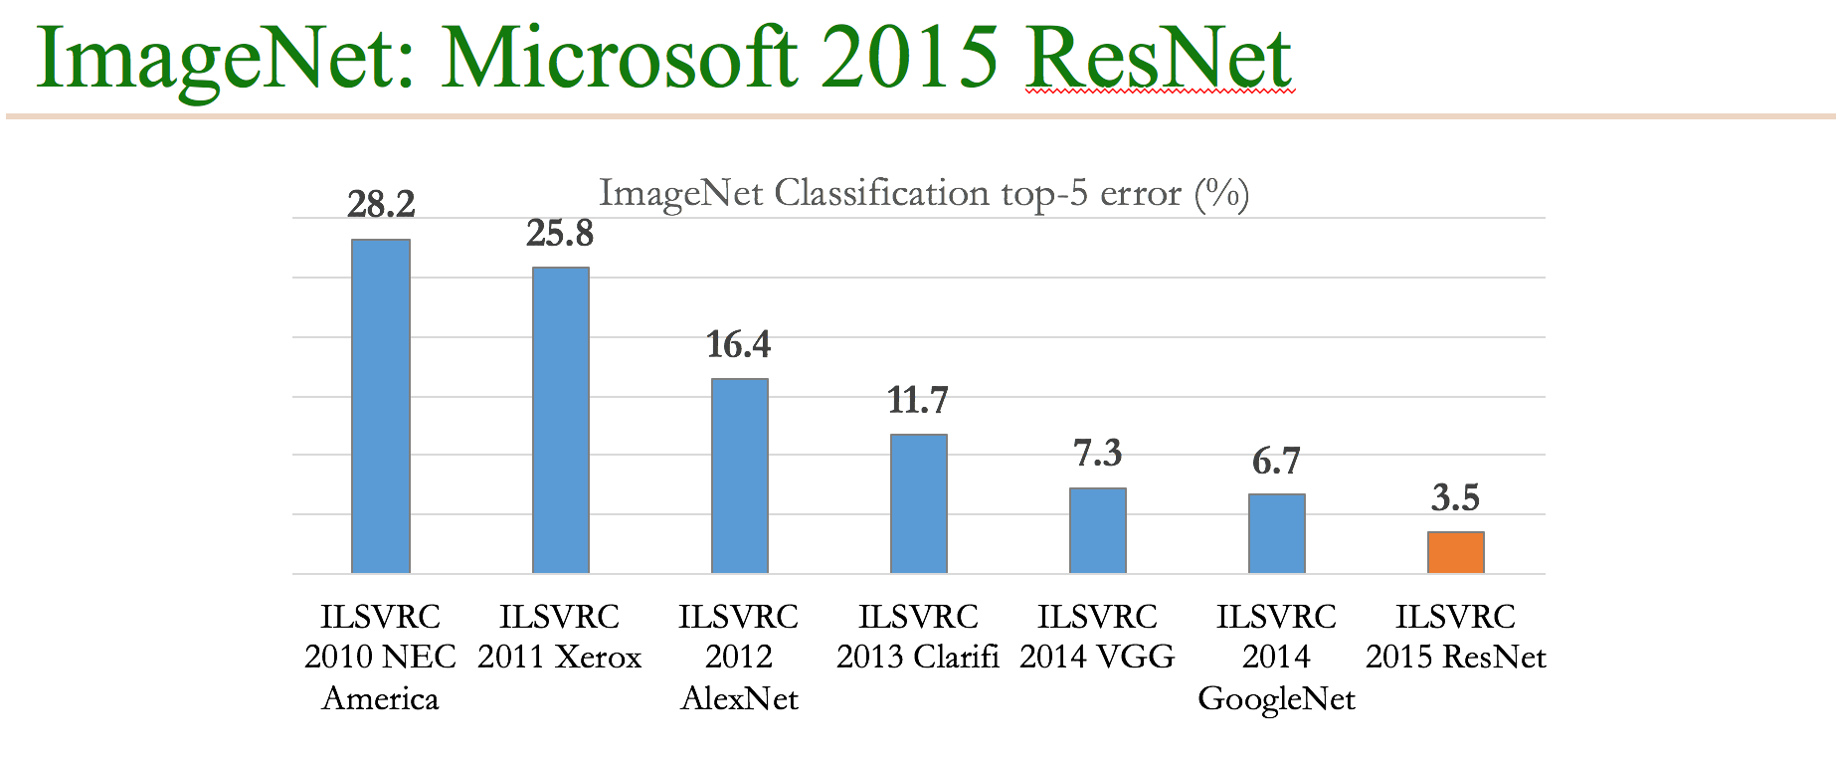
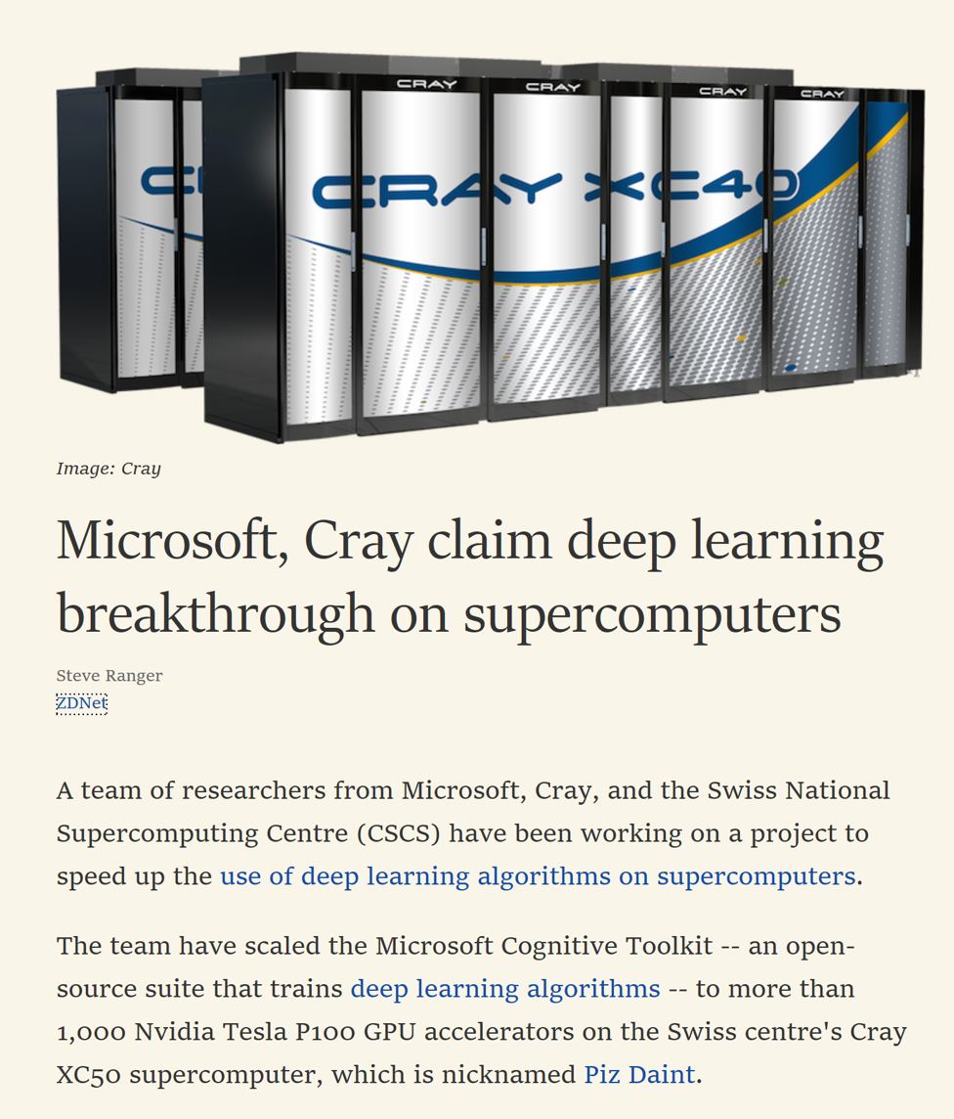
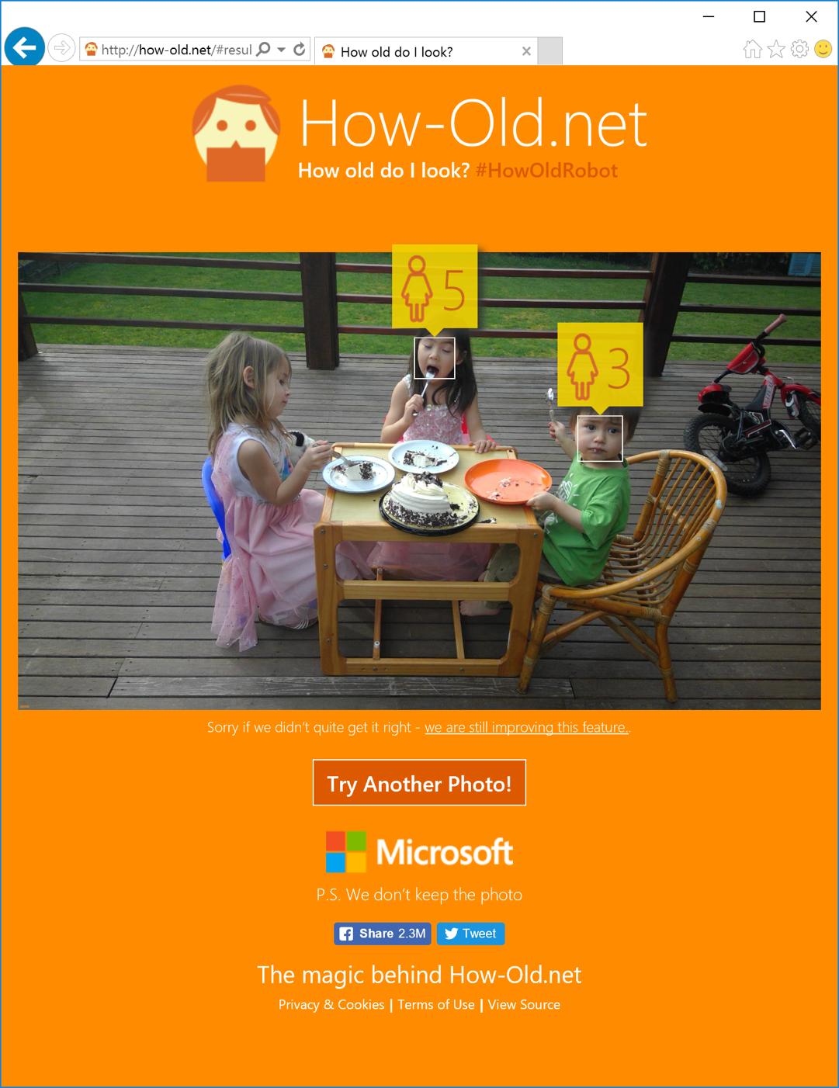
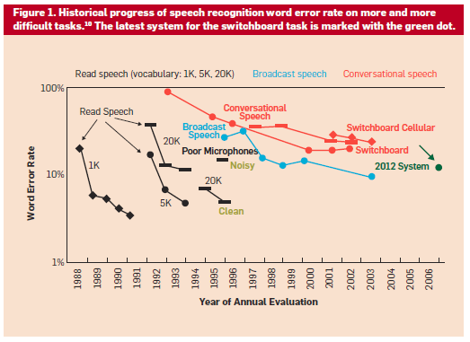
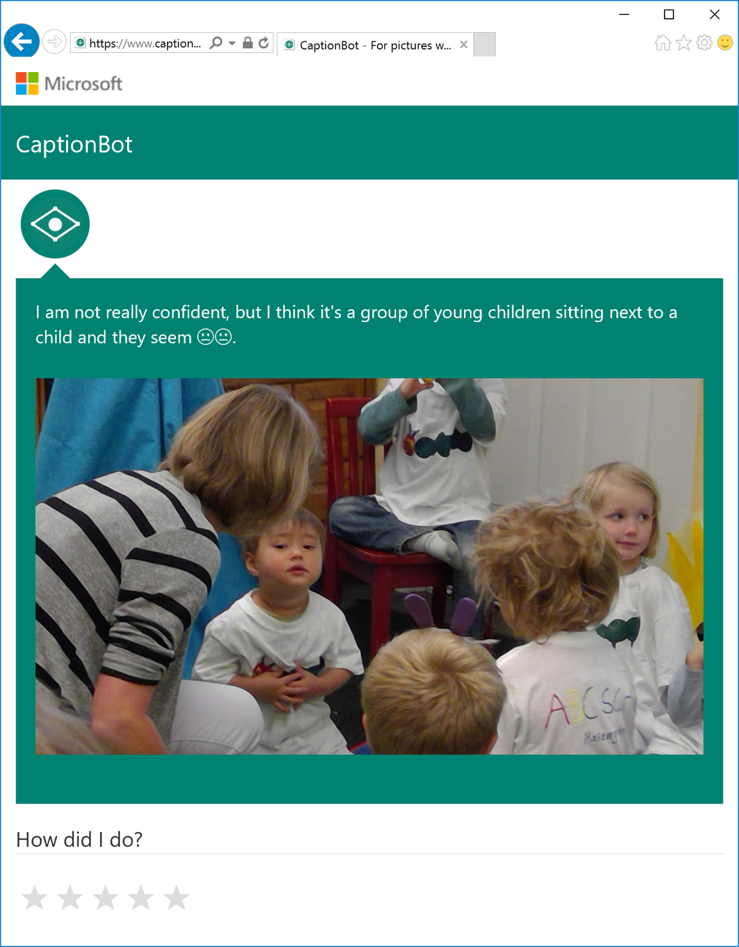
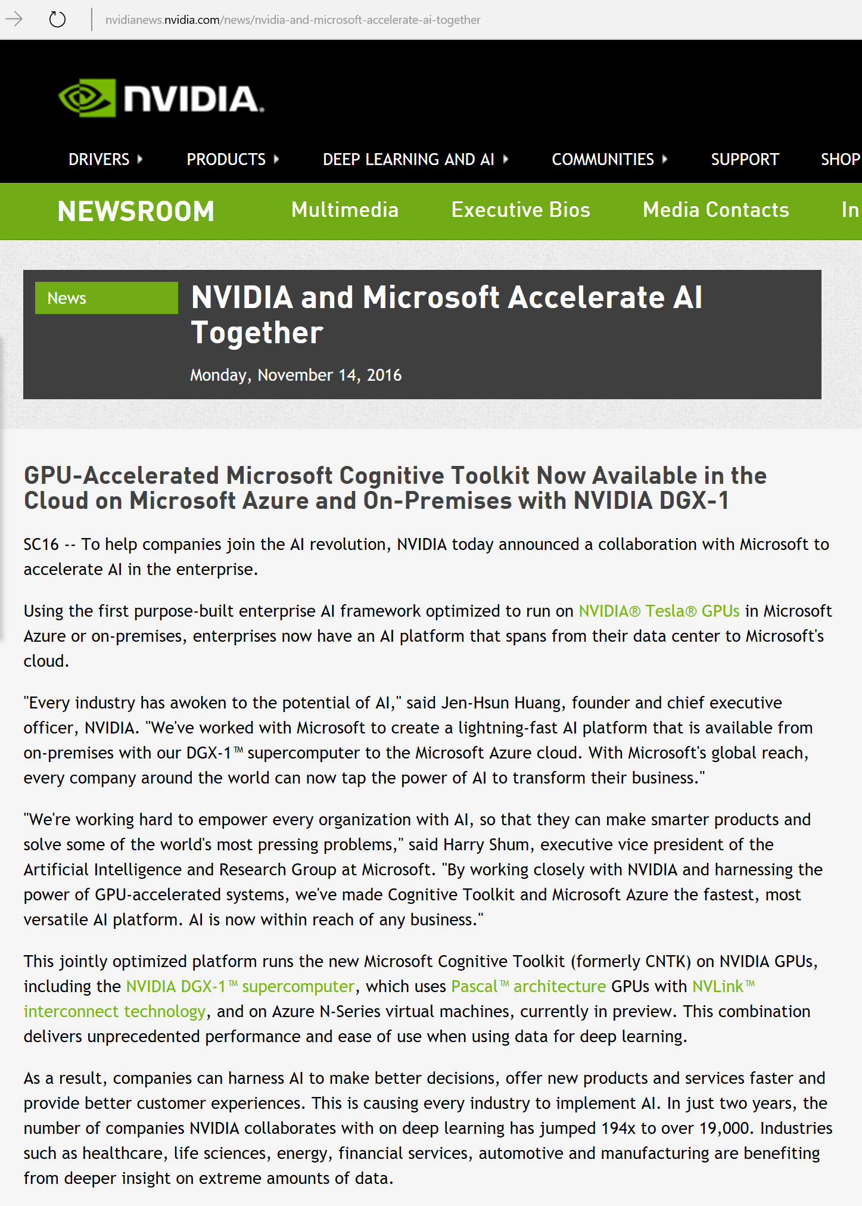


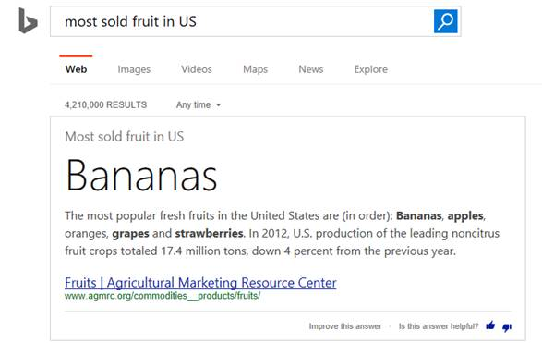


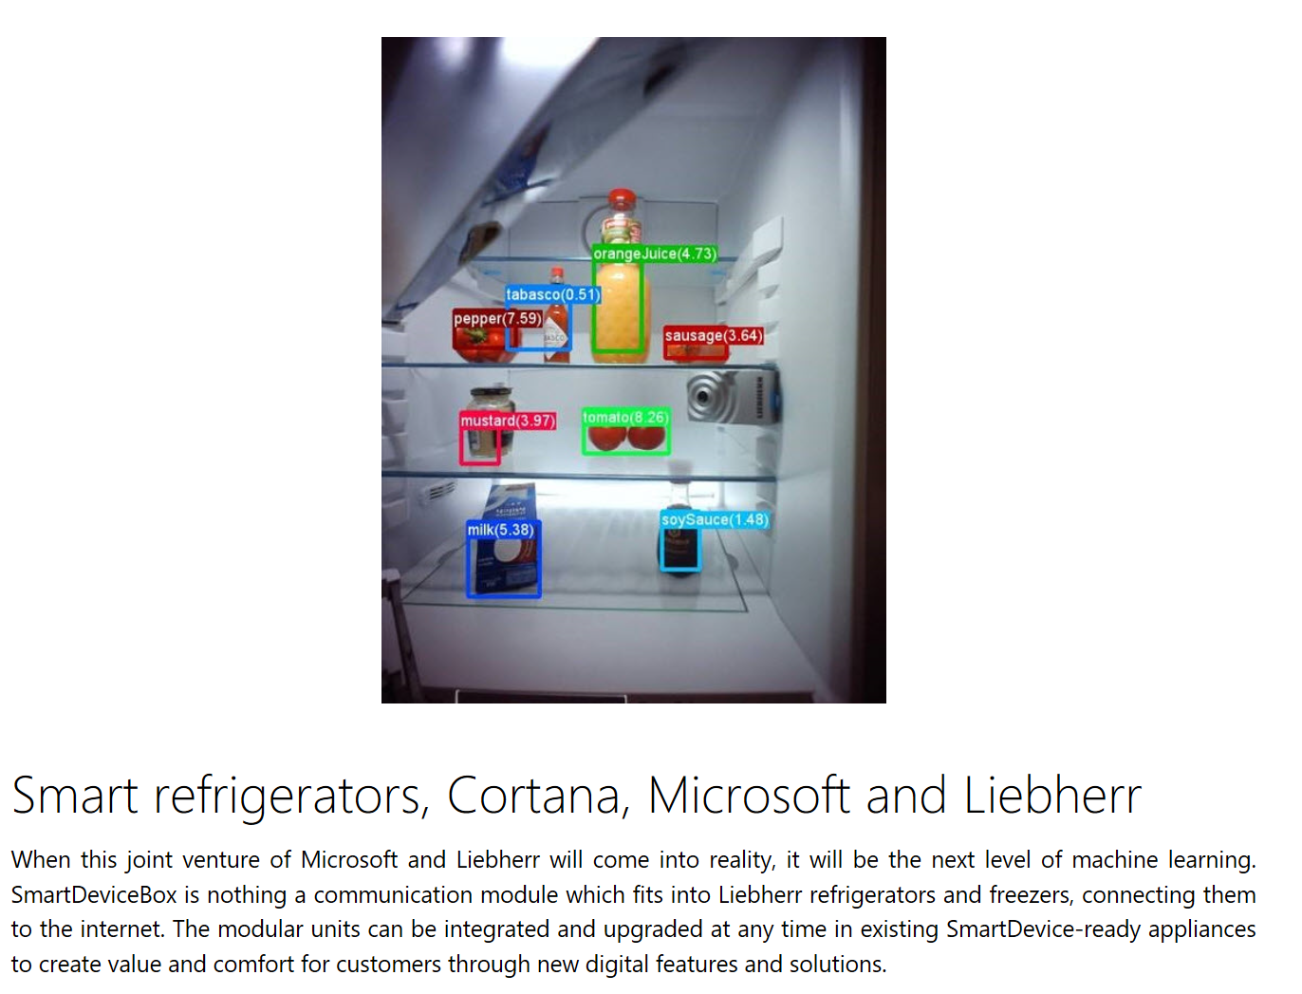
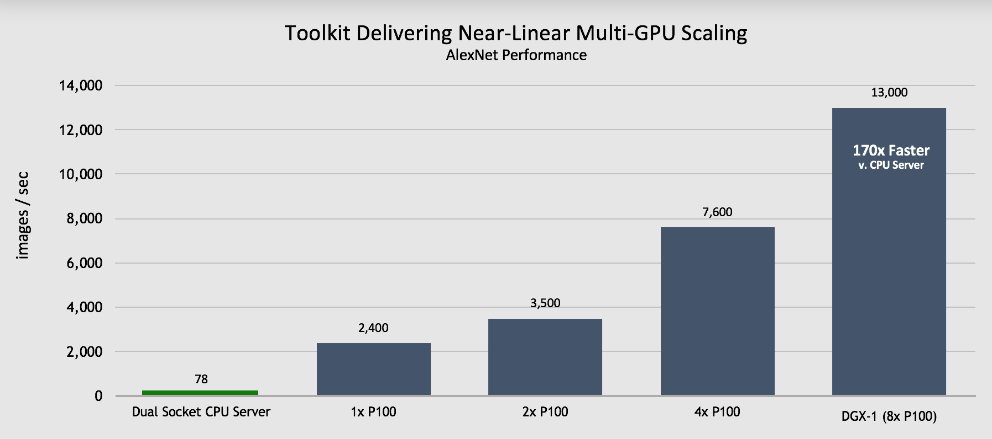

Cognitive Toolkit: Examples

Slide 16
Cognitive Toolkit: Examples
MSR

Slide 17
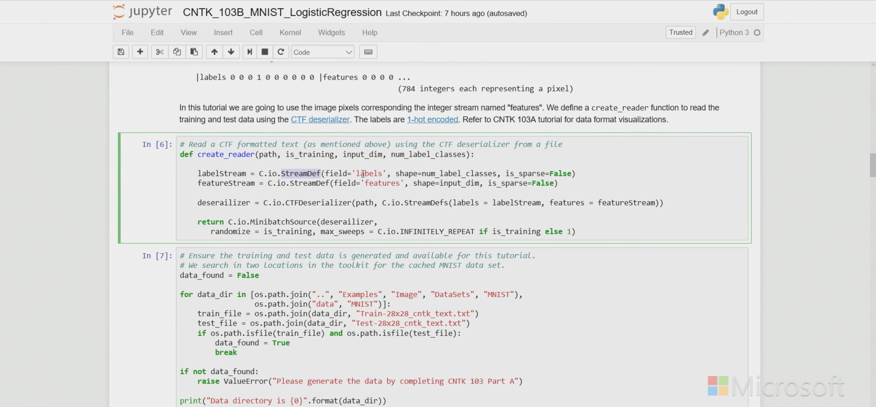
Cognitive Toolkit: Getting Started
Windows
CPU | GPU NuGet – CPU | NuGet – GPU | NuGet – UWP CPU
Linux
CPU | GPU | Docker – CPU | Docker – GPU Ubuntu 14.04, 16.04 | Requires OpenMPI
macOS
Docker – CPU
Cloud
Data Science Virtual Machine 🏅 | Azure Notebooks
Azure Batch AI Training (CPU/GPU), Project BrainWave (FPGA)

Slide 18
Cognitive Toolkit: Getting Started
Example: 2-hidden layer feed-forward NN
h₁ = σ(W₁ x + b₁)
h₂ = σ(W₂ h₁ + b₂)
P = softmax(W_{out} h₂ + b_{out})
with input x ∈ R^{M} , and cross-entropy loss
ce = y^{T} log P
Σ_{corpus}ce = max
ce
CrossEntropy
P
Softmax
h1 = Sigmoid (W1 * x + b1)
h2 = Sigmoid (W2 * h1 + b2)
P = Softmax (Wout * h2 + bout)
b_{out}
+
W_{out}
•
h₂
σ
b₂
+
W₂
•
ce = CrossEntropy (y, P)
h₁
σ
b₁
+
W₁
•
x
y

Slide 19
Demo
Cognitive Toolkit

Slide 20
More please
edX: Deep Learning Explained (Microsoft DAT235)
Ch9: Deep Learning with CNTK
Notebooks: CNTK Tutorials
GitHub: CNTK

Slide 21
How do I <insert your feature here>?
Cognitive Toolkit. Maybe.
Language
Dynamics 365
Skype
Knowledge
Speech
Browser
Azure Bot Service
Cognitive Services
Vision
Cortana
Web
Azure ML
Cognitive Toolkit
Notes:
Labs, sessions

